Slide 1
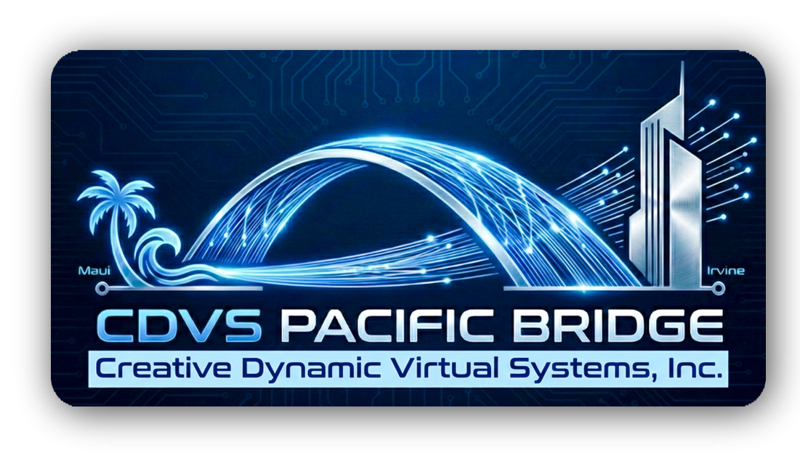

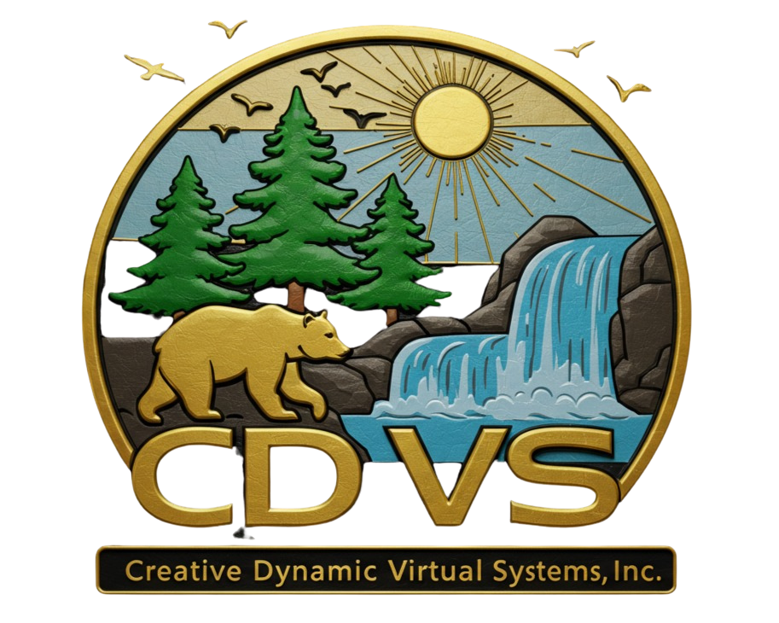

Innovating Together: An Introduction to CDVS
Prepared for the IBM Team: Eric Saber, Ken Graff, David Reyes, Jonathan Sloan, Michael Geer, and Marc Passarella.
Technical Architecture and Real-Time Synchronization
Prepared and delivered by Kevin R. Turner
February 25, 2026

Slide 2
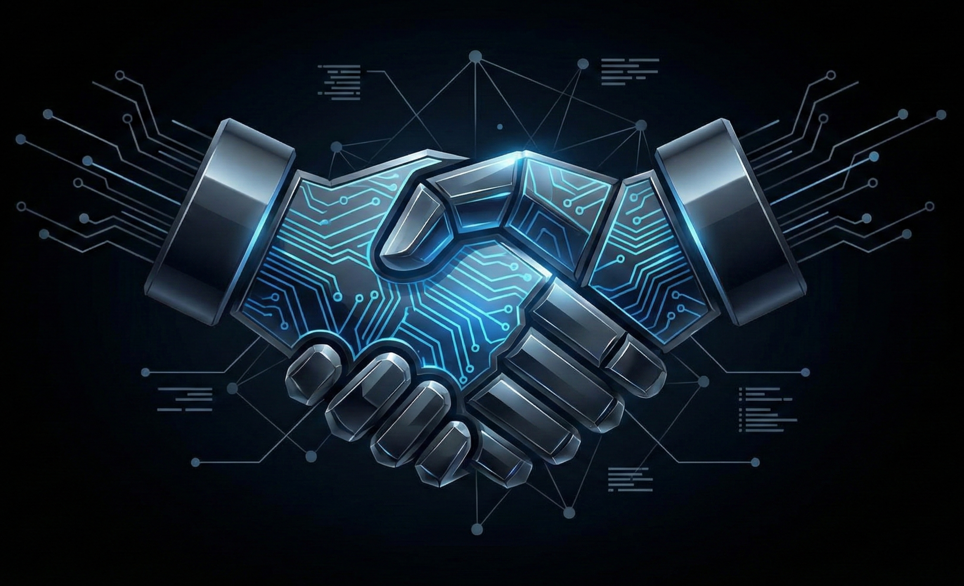
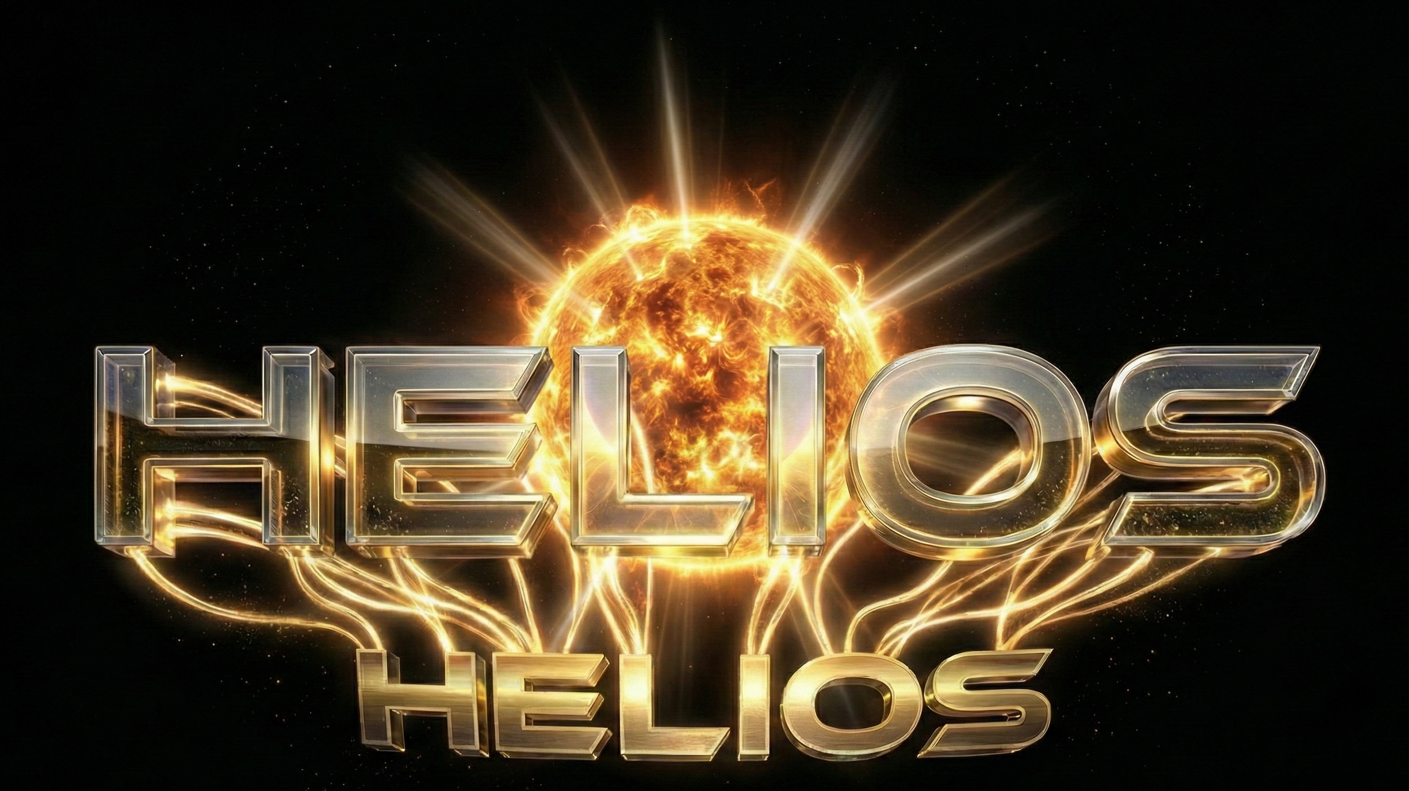
Thank You for Your Time
The HELIOS Project™ by: Creative Dynamic Virtual Systems, Inc. (CDVS)
Time is your most valuable asset—thank you for sharing it with us today.
Our Goal Today: To introduce the core mission of Creative Dynamic Virtual Systems (CDVS) and explore potential synergies.
"First and foremost, Eric, Ken, David, Jonathan, Michael, and Marc—thank you. I know how demanding your schedules are at IBM, and I truly appreciate you taking the time out of your day to be here. My goal today isn't to give you a heavy sales pitch, but rather to pull back the curtain on Creative Dynamic Virtual Systems—who we are, what drives us, and why we believe our approach could be highly relevant to the work you do."

Slide 3

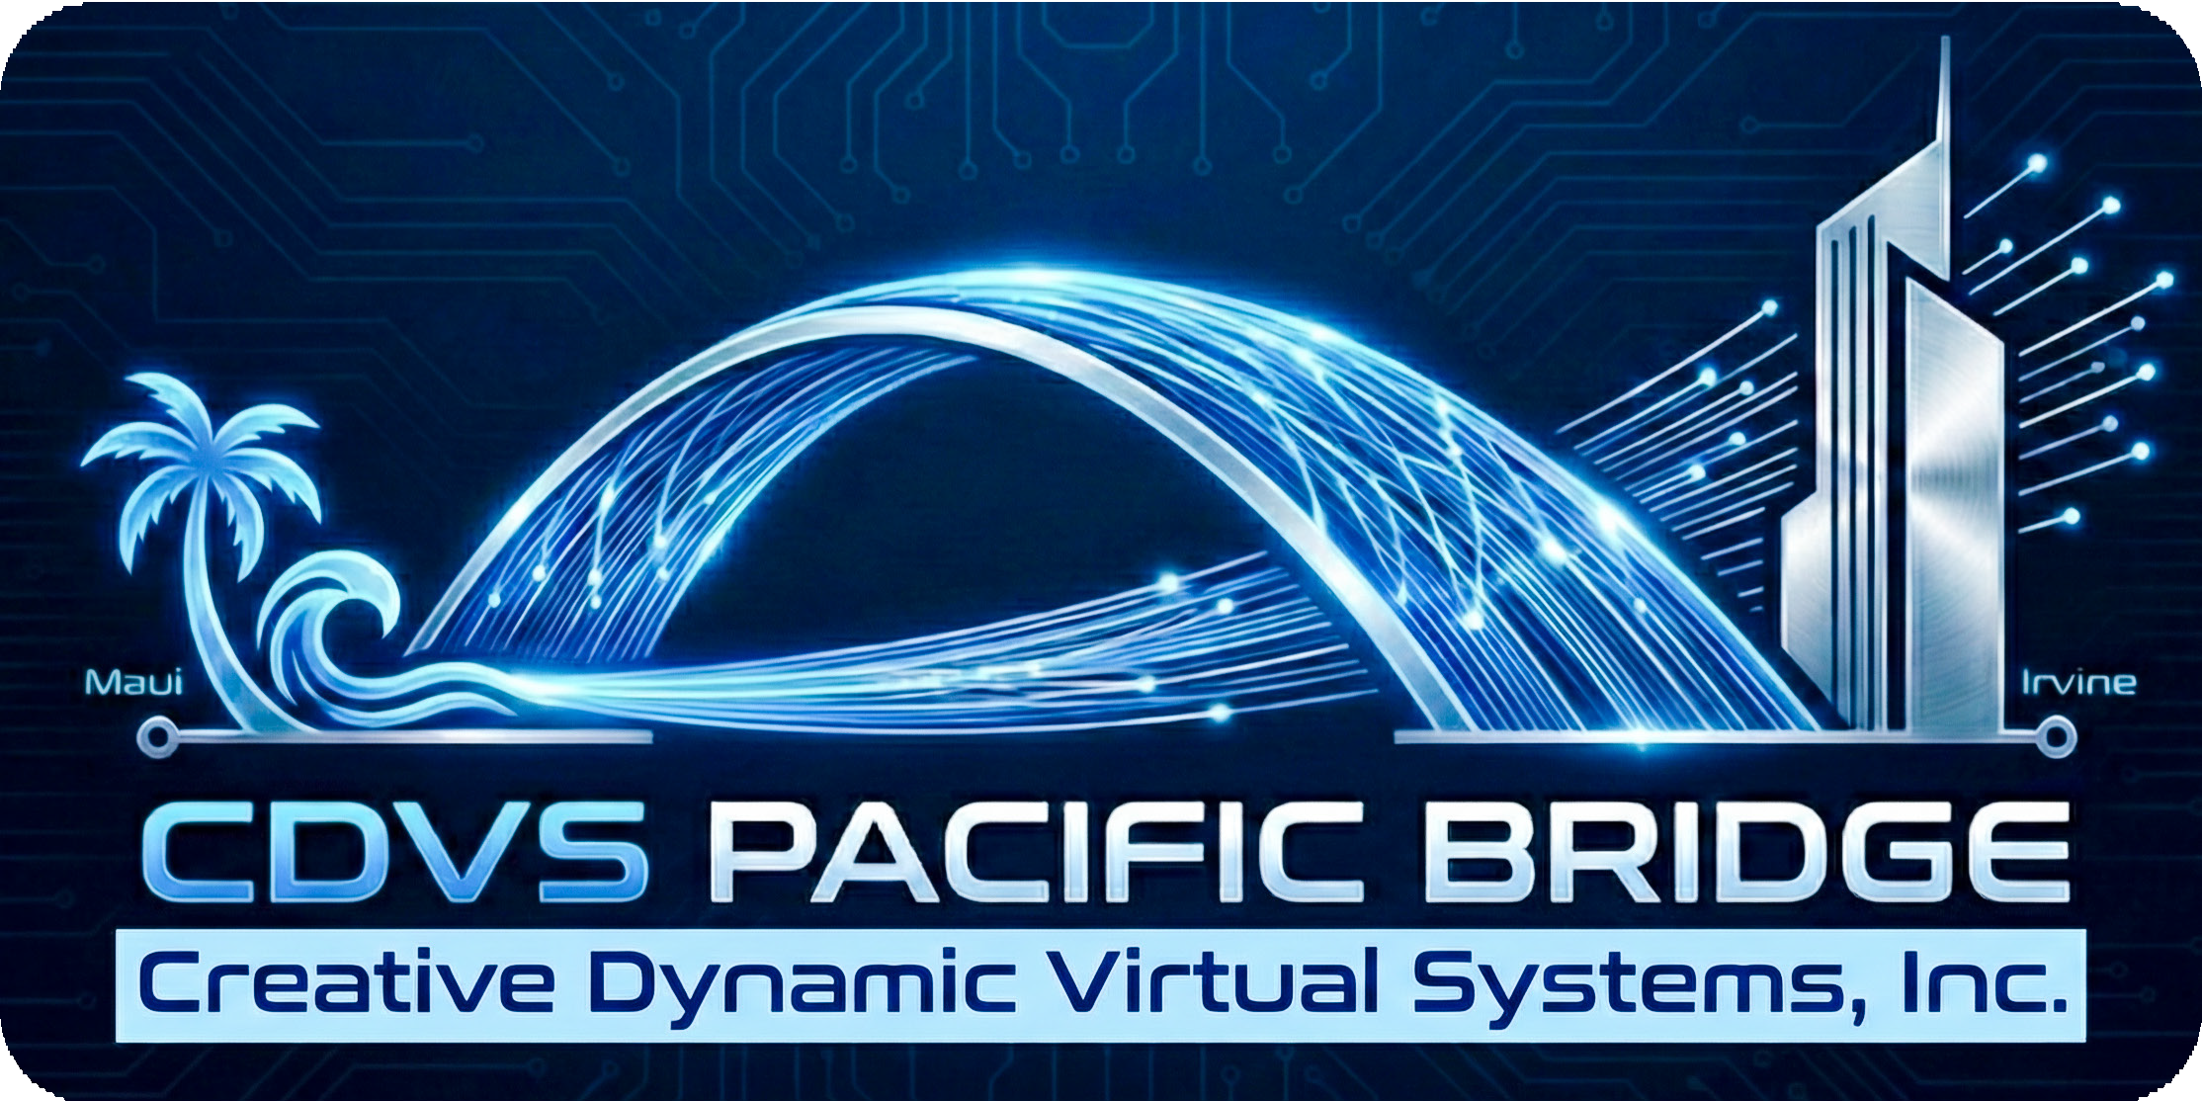
The Landscape
Introduction to the HELIOS Project & the Pacific Bridge connection
Real-Time Data Link: Paciﬁc Bridge
Connects IBM z17 compute core (Irvine) to NASA CAVE/GRUVE (Maui)
Dedicated high-speed ﬁber and laser-comm ensure ultra-low latency
High-Fidelity Holographic Streaming
Transforms bioprinter telemetry into immersive 3D holograms
Enables surgeons to interact with live or simulated bioprinting events
Advanced Security and Data Integrity
Quantum-safe encryption (Kyber) protects IP during transmission
CDVS Blockchain ensures immutable digital thread for all surgical data
2

Slide 4

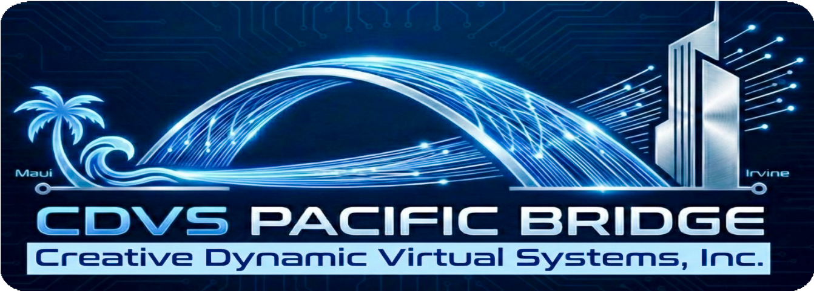
Who We Are (The "What")
Streaming Architecture Overview
Hardware-Level Encryption & Packetization
IBM z17 DPU encrypts and packetizes data at the hardware layer.
Ultra-Fast Data Transport
Dedicated high-speed ﬁber or
laser-comm link ensures rapid, secure transmission.
AT&T partnership provides robust infrastructure for Paciﬁc Bridge operations.
Direct Memory Access for Minimal Latency
RDMA over Converged Ethernet (RoCE) v2 enables Maui nodes to pull data directly from z17 memory.
Bypasses CPU intervention, achieving near-zero lag for real-time holographic streaming.
3

Slide 5


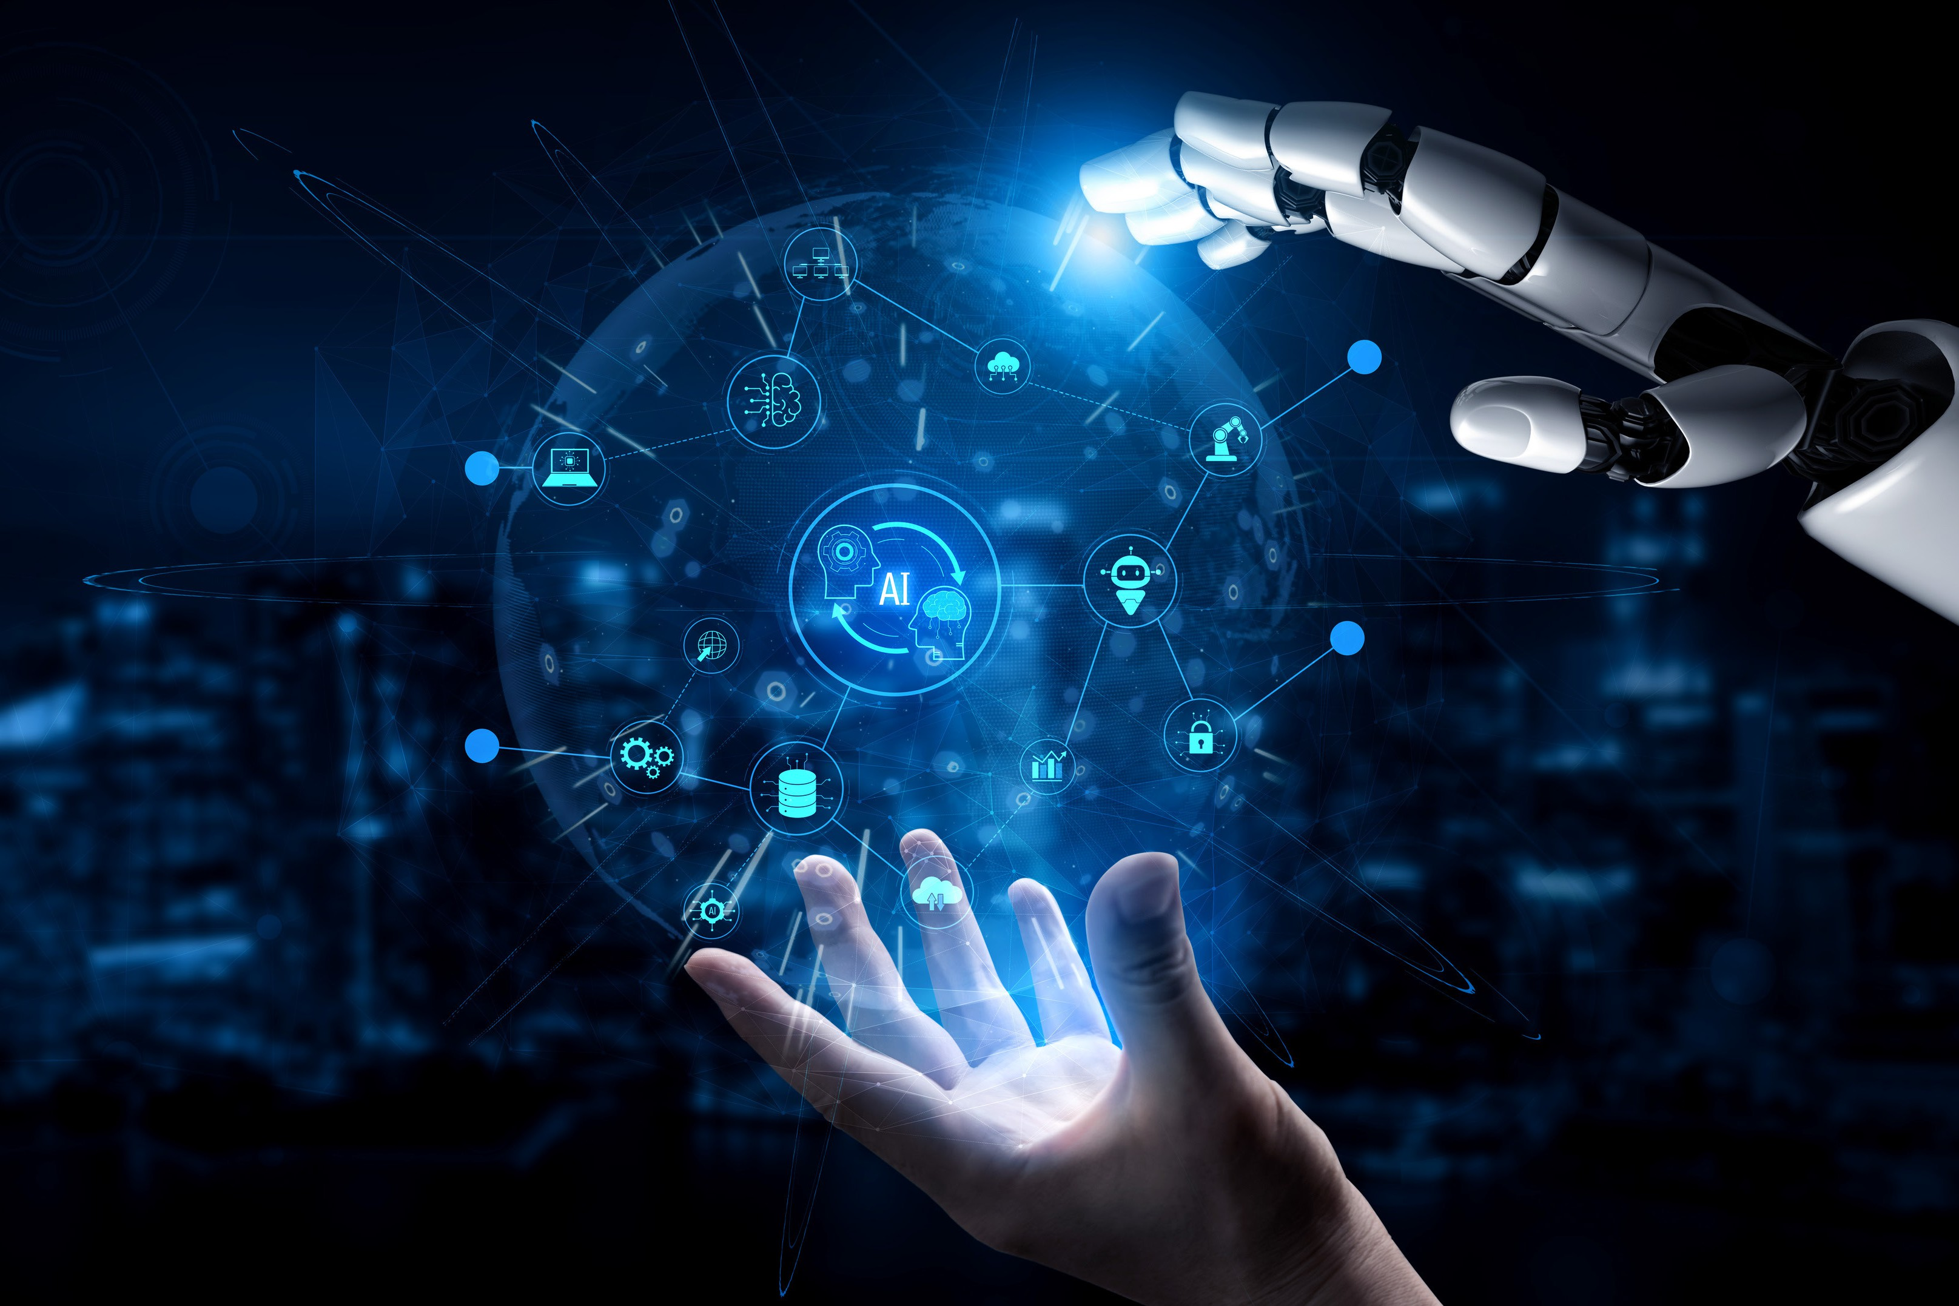
The CDVS Advantage (The "How")
Data Transformation and Rendering
Real-Time Telemetry Conversion
Informix Real-time data is transformed into 3D mesh models.
Neural-Viz Python Bridge Processing
Ingests Neural-Ledger hashes and bioprinter telemetry for volumetric point cloud generation.
Spyre Accelerator Tessellation
Executes advanced skinning algorithms to render visible Bio-Glass scaffolds from point cloud data.
4

Slide 6

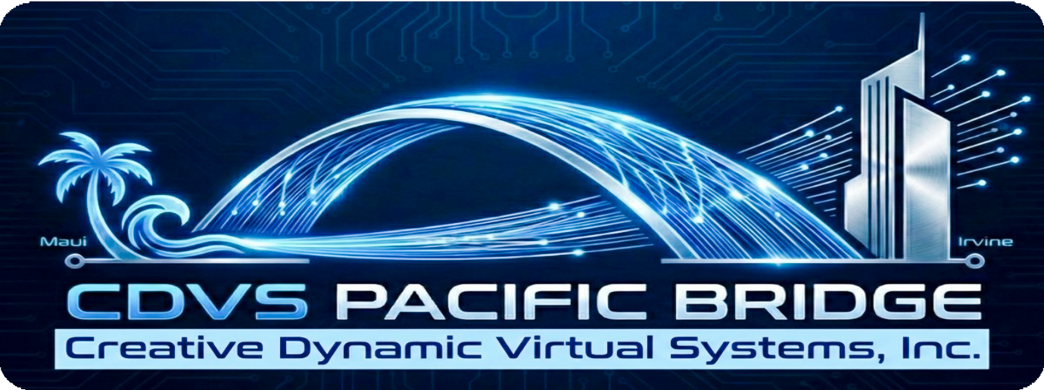
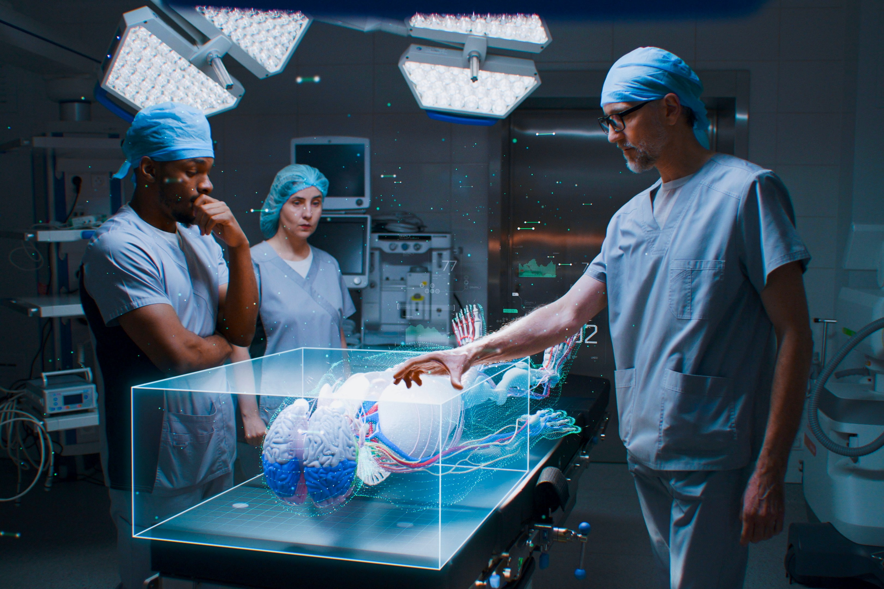
Synergy with IBM
Immersive Visualization Holographic Integration
Room-Scale Holographic Visualization
NASA CAVE/GRUVE systems deliver immersive, glasses-free 3D environments.
Multi-user access enables collaborative surgical planning and manipulation.
Dynamic Spatial Tracking
User head position tracked for real-time perspective recalculation.
Hologram adapts instantly as users move within the environment.
Haptic Force-Feedback Integration
Streams elasticity data to haptic gloves, simulating tissue feel.
Surgeons experience tactile feedback during bioprinting events.
5

Slide 7


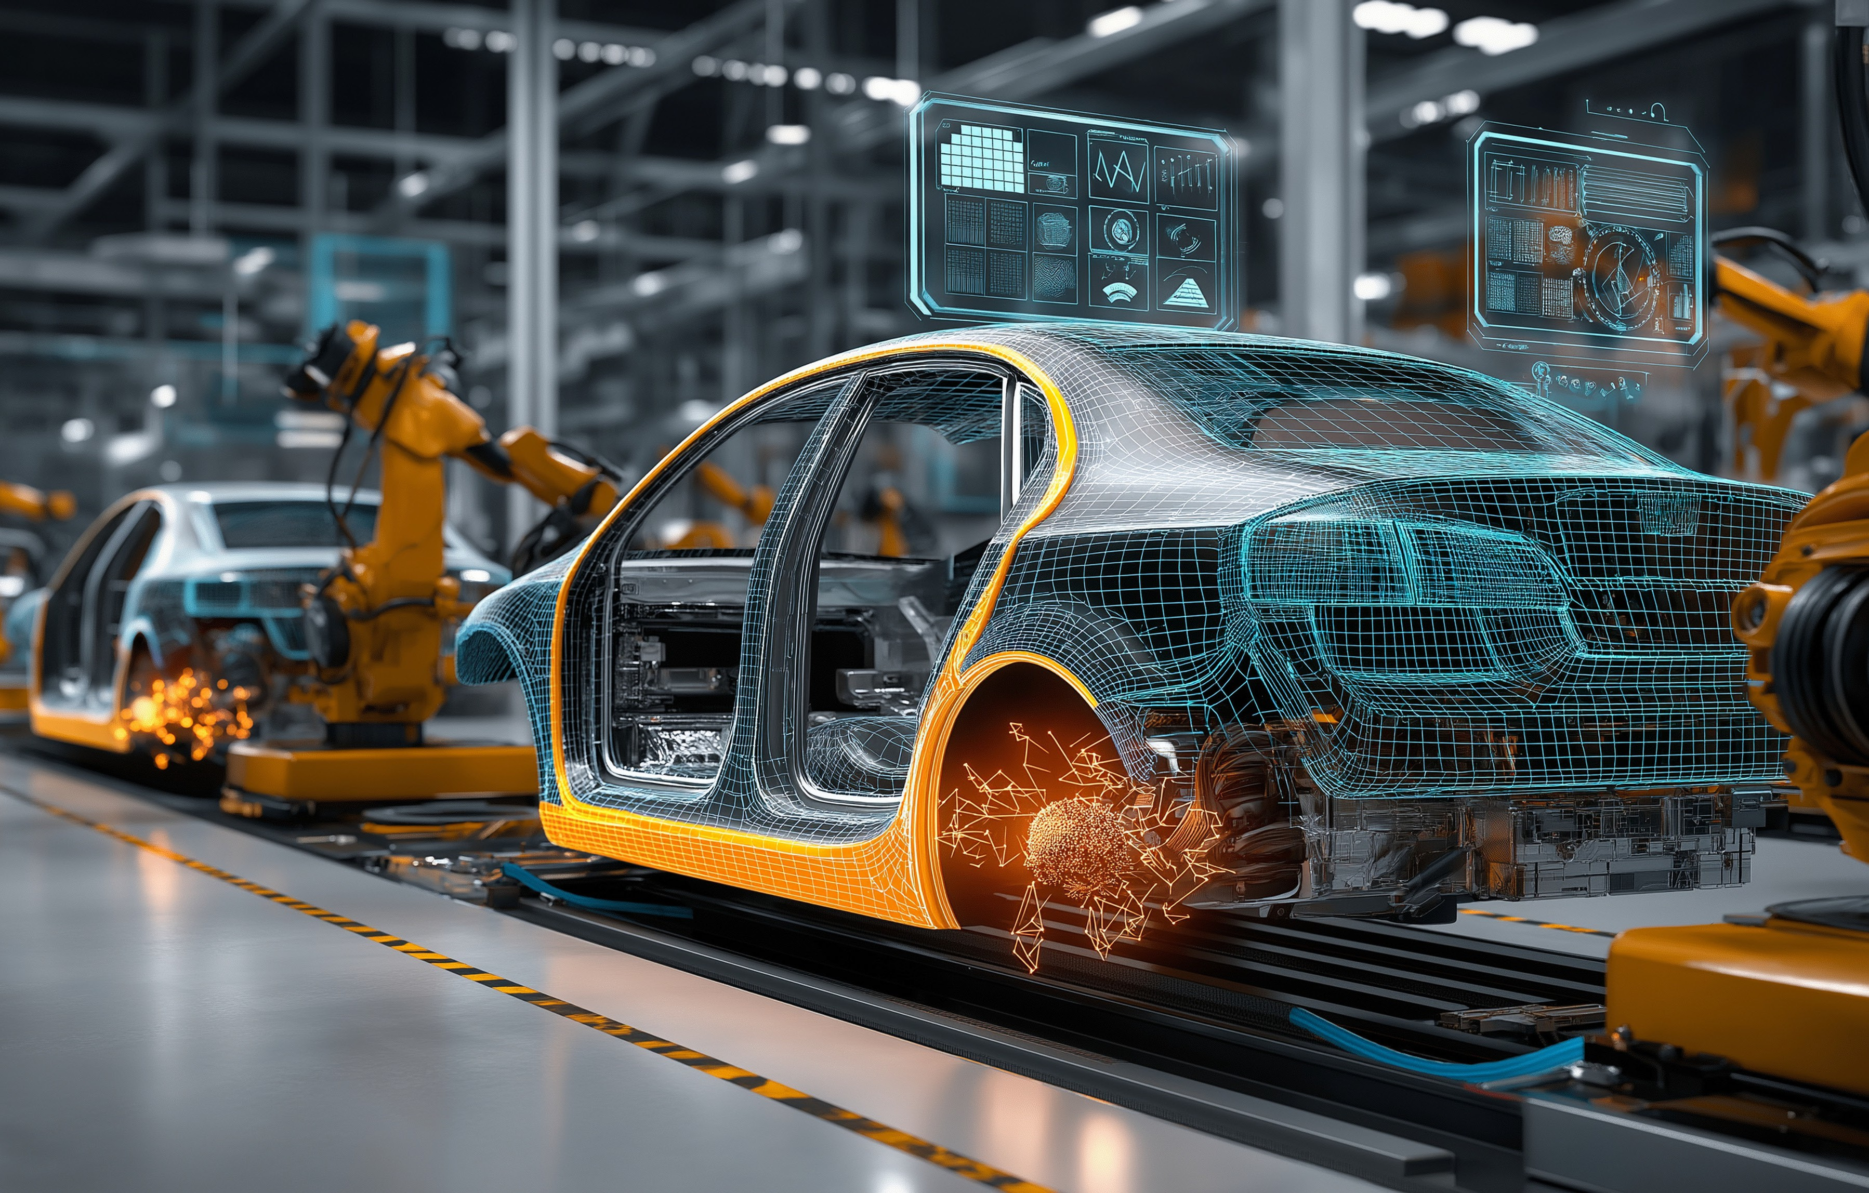
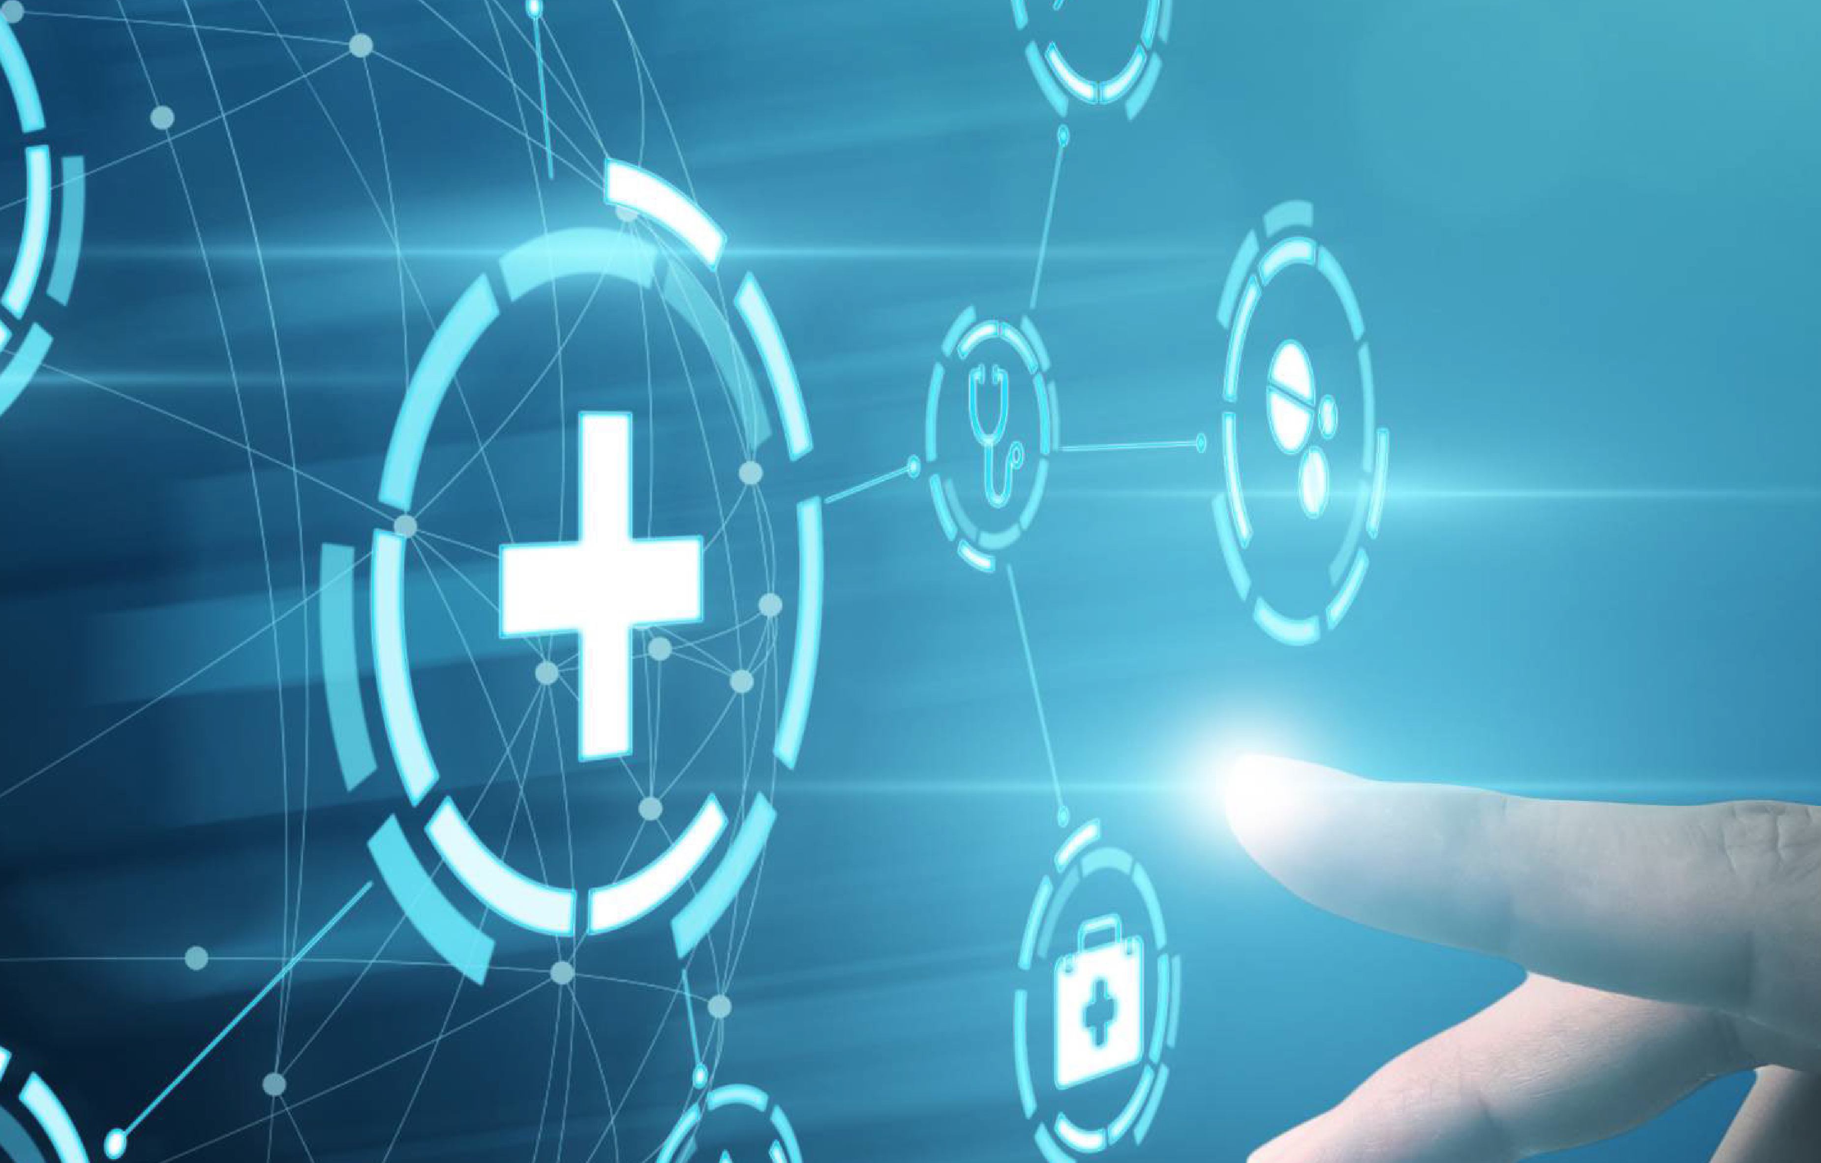

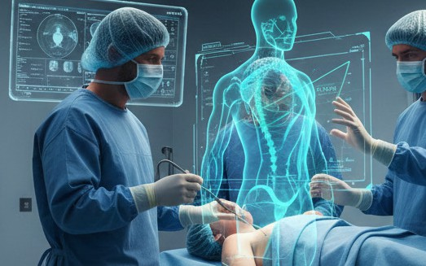
Q&A and Next Steps
Digital Twin Overlay and Holographic Correction & Design
Multi-Layer Visualization Overlay
Displays real-time physical print, HELIOS AI ideal, and deviation heatmap.
Neural-Ledger Correction Mechanism
Detects deviations and issues corrective commands to bioprinter.
Visual feedback: hologram shifts from warning (red) to corrected (green).
Immediate Surgical Insight
Surgeons observe live adjustments, ensuring optimal tissue fabrication.
6

Slide 8

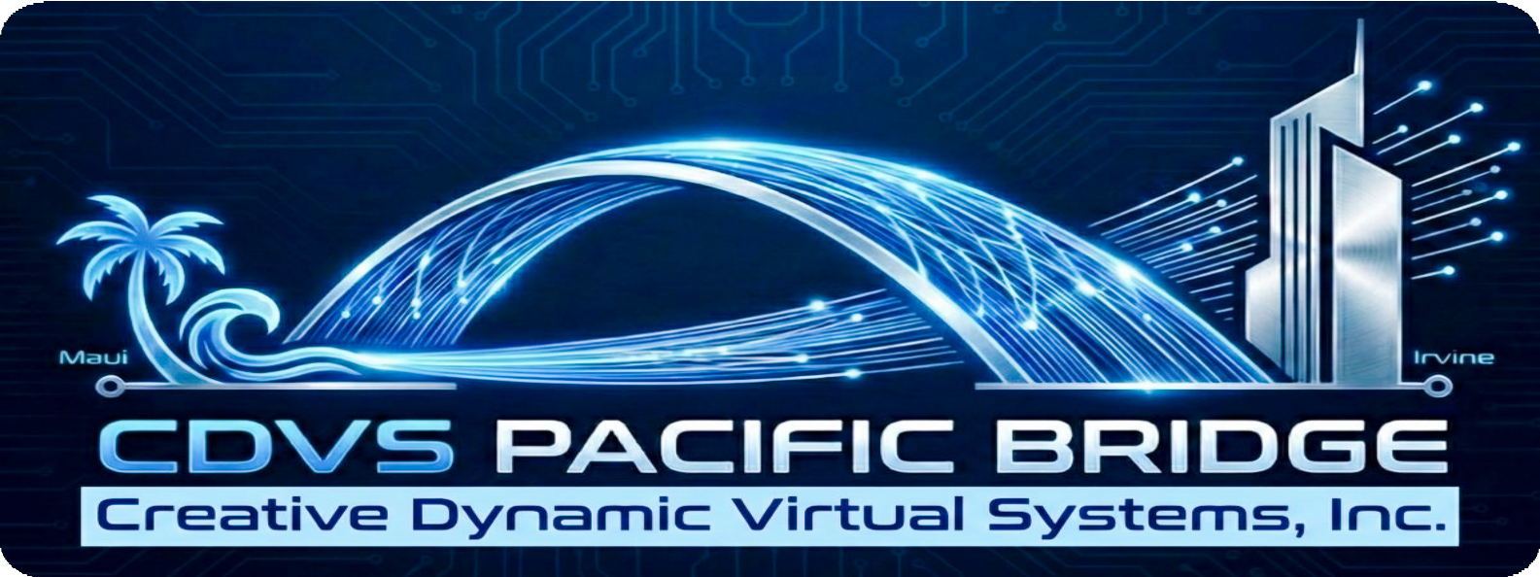
Quantum-Safe Security Measures & BlockChain
Quantum-Safe Encryption with Kyber
z17’s CPACF encrypts every 3D frame using Kyber (ML-KEM), the NIST-approved quantum-safe algorithm.
End-to-End Data Protection
Holographic streams remain secure even if transmission channels are compromised or intercepted.
Hardware-Level Security Integration
Encryption and packetization handled directly by z17’s Data Processing Unit for maximum efﬁciency.
7

Slide 9

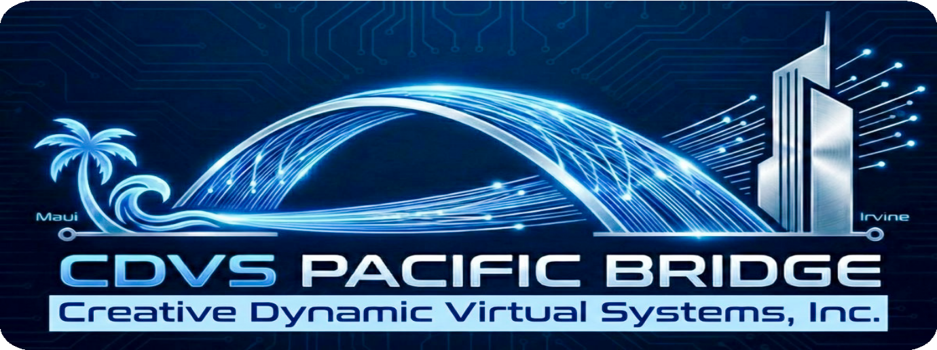
Technical Requirements Summary
Component | Requirement
Network Interface | 2x 100GbE RoCE Express3
Encryption | Quantum-Safe Kyber Algorithm
Software | Open-Shift on z/OS
Hardware | NASA GRUVE System
18

Slide 10

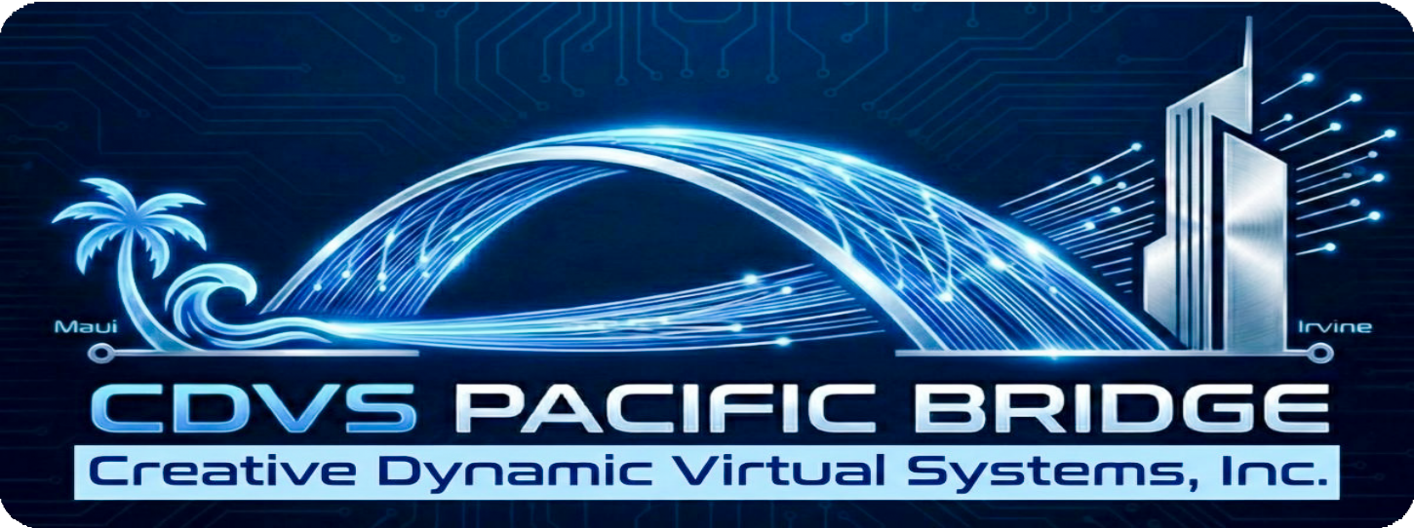
Key Takeaways and Impact
Real-Time,
Cross-Continental Synchronization
Paciﬁc Bridge streams bioprinting data between Irvine and Maui with zero perceived lag.
Utilizes RDMA over Converged Ethernet (RoCE v2) for direct memory access, bypassing CPU bottlenecks.
Advanced Data Integrity and Security
IBM z17 DPU encrypts and packetizes data at hardware level.
Quantum-safe Kyber encryption protects IP during transmission, even against cable tapping.
Immersive Visualization and Surgical Collaboration
NASA CAVE/GRUVE systems render high-ﬁdelity holograms for multi-user, glasses-free surgical planning.
Haptic feedback enables tactile interaction with bioprinted tissue models.
Operational Efﬁciency and Leadership
Supports seamless research and surgical monitoring, positioning CDVS at the forefront of medical technology.
9

